Slide 1
Forms and Event Handling
ngModel
Accessing input values through two-way binding
Event Handling

Slide 2
Angular Forms
Angular forms use the ngModel attribute to declare which model/variable of the component the form item will get and set its value to
The term model simply means data store
You can store the data from an input in a single variable or in an object which contains the form's values
Form
Component
name:string = "";
password:string = "";
dob:string = "";
input [(ngModel)] = "name"
input [(ngModel)] = "password"
input [(ngModel)] = "dob"

Slide 3
ngModel
ng is short for Angular
We can declare that the value for the input is bound to a variable (through data binding)
The value of the variable will be updated whenever the input changes
The following binds the value of the input text field to the variable firstName:
<input type="text" [(ngModel)]="firstName" name="firstName">
Note that the name attribute of the input must also be defined
Note also that the binding is two-way, the initial value of the firstName variable will be the initial value shown in the input. This is using the "banana in a box" notation [( )].

Slide 4
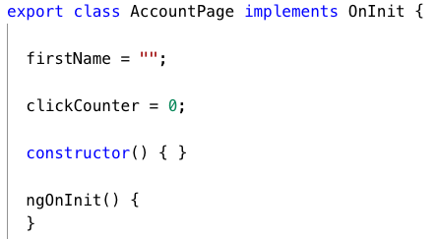
ngModel bound variable
The ngModel expects to find the bound variable in the class of the component:
The property must be given an initial value, otherwise it won't work at all

Slide 5
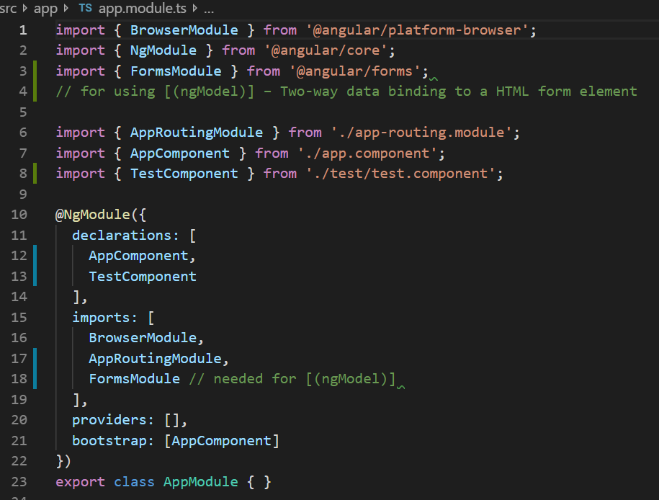
NgModel - FormsModule
The FormsMoudle must be imported to your module for [(ngModel)] to work. This can be done in the app.module.ts file

Slide 6
Accessing input value
We may not need to access the value of the input field every time there is a change, but instead when a button is pressed
We can do this two ways:
Add a click handler on the button and then access the property in the event handler
Create a form with a submit handler and create button of type submit

Slide 7
Event Handling
Event Handling is the technical term for User Interaction
We can think of every user interaction as an event
Events could be mouse movement, click, touch or swiping the screen, a gesture, or even data arriving over the network
Using routes, we can cause a page to change based on the route specified on the component
But what if want to execute some logic?
For example, check a password before showing the next screen
We can add event handlers to components to execute our own code

Slide 8
Event Handling
Event handling links together three things:
Event source (e.g. button)
Event action (e.g. click)
Event handler (e.g. code to run when event occurs)
Event Handler
Event Source
Event action

Slide 9
Events
Events are simply HTML/JavaScript events
We link the source of the event, the action, and event handler within the component in the template HTML
Event actions are specified using parentheses, for example:
<button (click)=”itemClicked()”> submit <\button>
This links the event source, the button with the event action, (click), to the event handler, “itemClicked()”, which is defined in the ts file of the component.

Slide 10
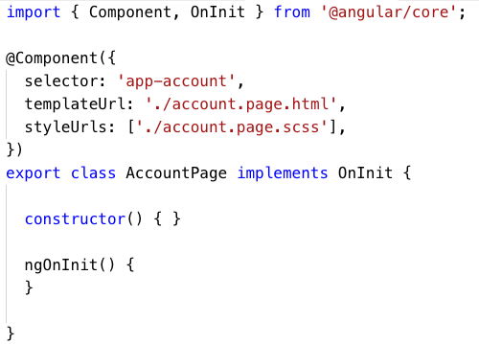
Event Handler
The event handler is code that we write to do something when the event occurs
Where does the event handler go?
The event handler will be a function in the component class

Slide 11
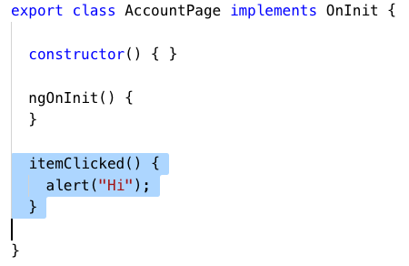
itemClicked() event handler
Below is a simple itemClicked() event handler which displays an alert when the item is clicked:
In TypeScript, functions inside classes do not have ‘function’ in front of them

Slide 12
Event and Data Binding
Earlier we discussed how Angular uses Data Binding to display data in a HTML template
Events often result in a change to the display
If we want to change a value displayed we should:
Create a property in the component to store the value
Display it in the template using a data binding
Change the component property when the event occurs

Slide 13
this
In the event handler we may precede the reference to the component property with this
this is required when referring to properties of the current component (i.e. class)

